Slide 1
Lab 1: Basic Unit Testing
Software Testing 2021
2021/03/04

Slide 2
JAVA IDE

Slide 3
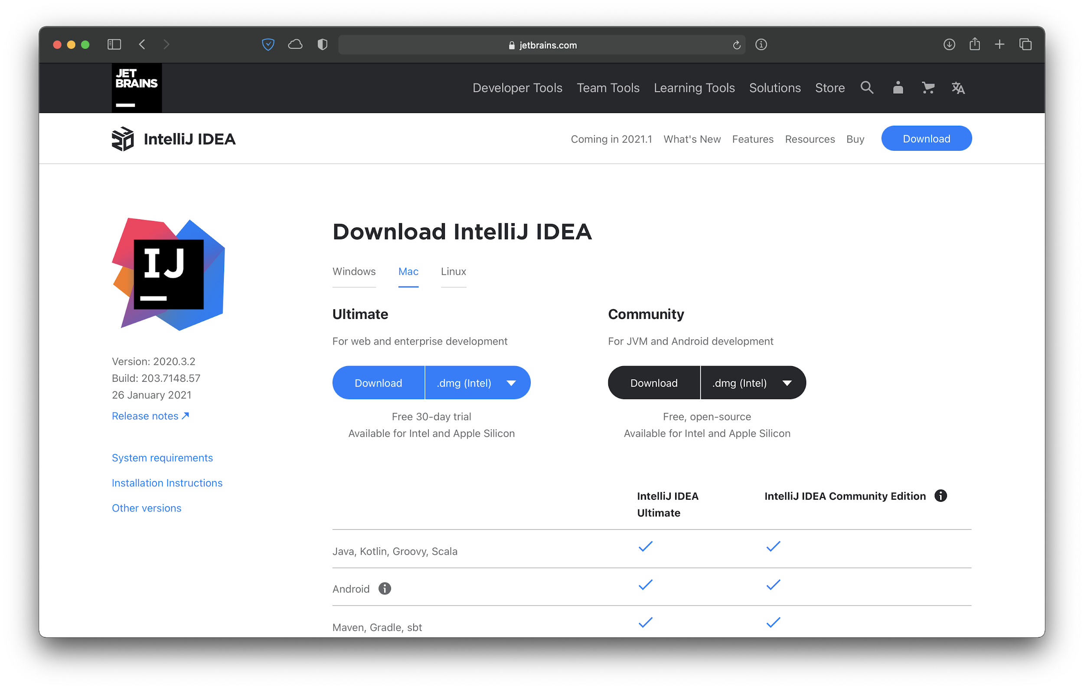
IntelliJ IDEA Community
https://www.jetbrains.com/idea/download

Slide 4
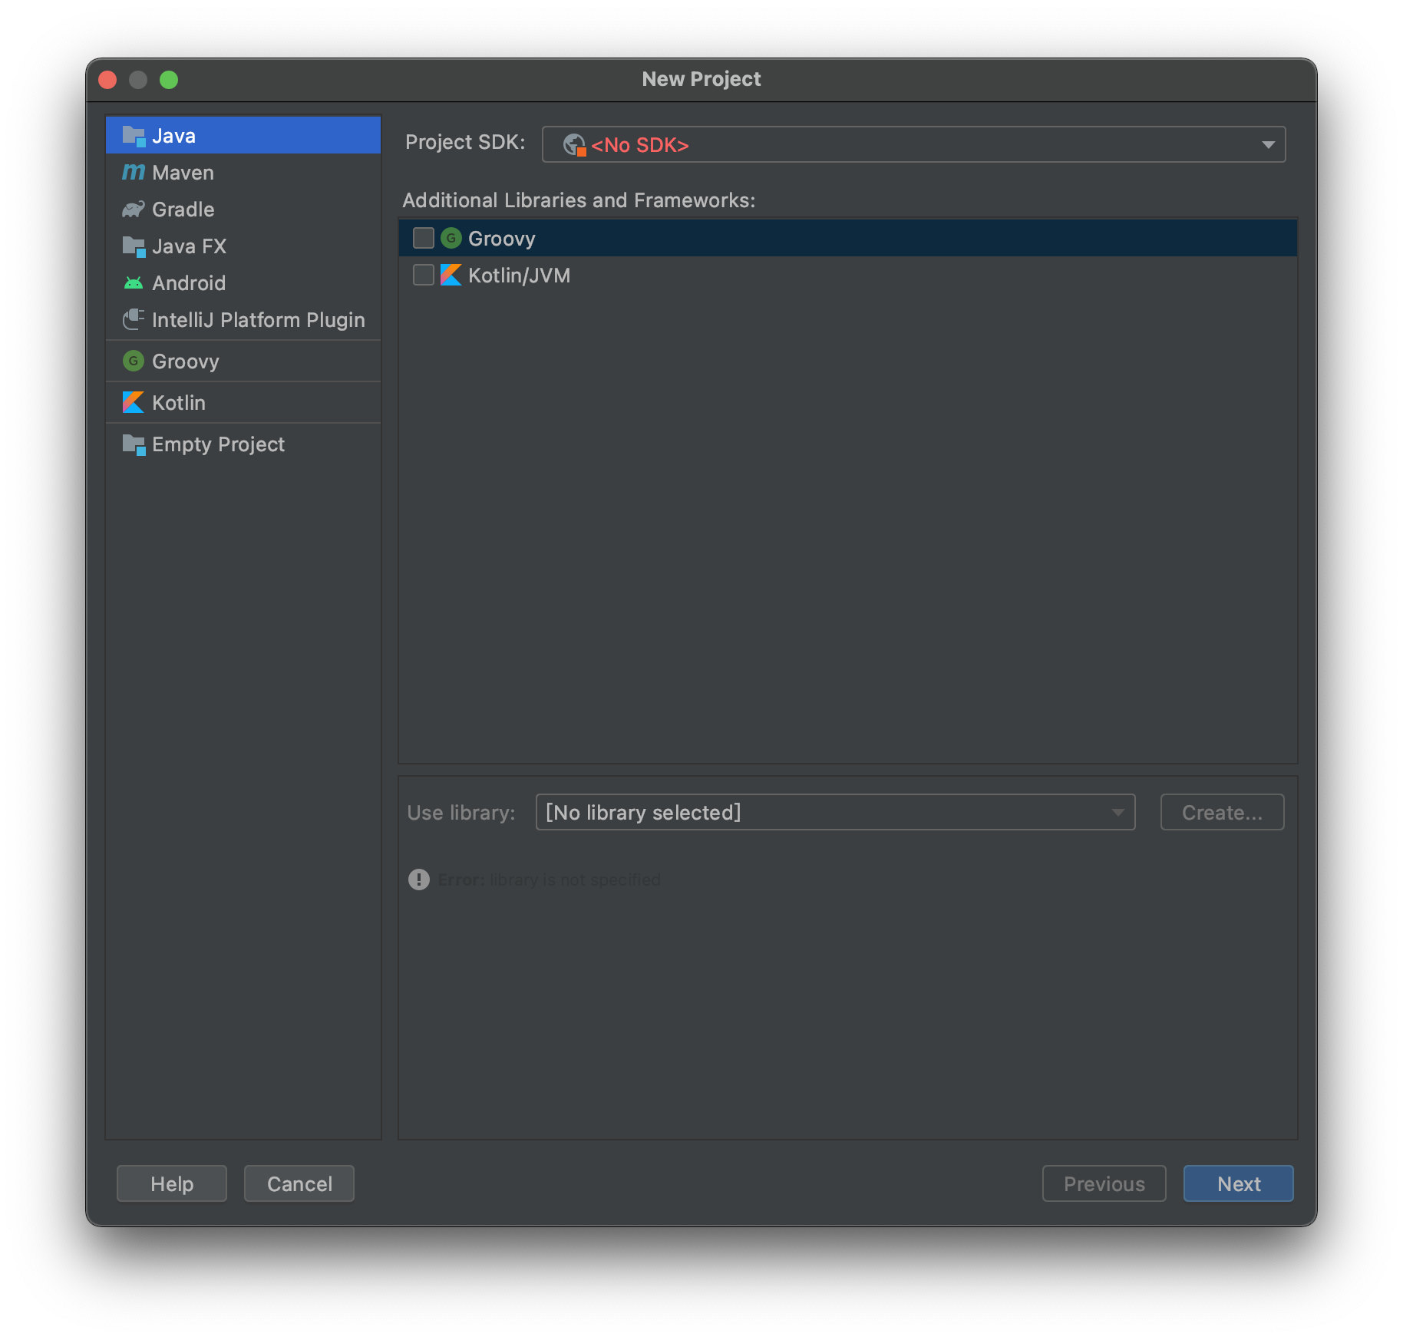
Guide - SDK

Slide 5
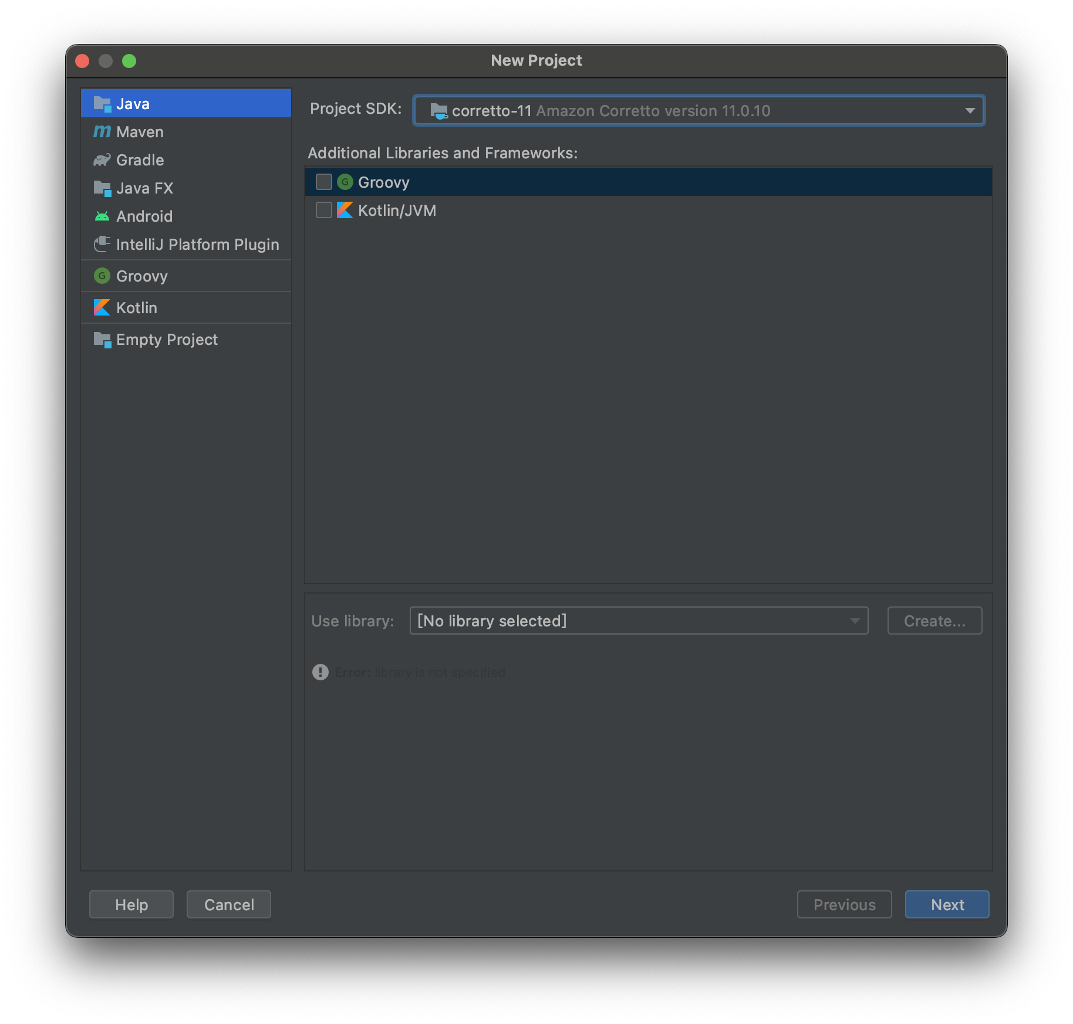
Guide - SDK

Slide 6
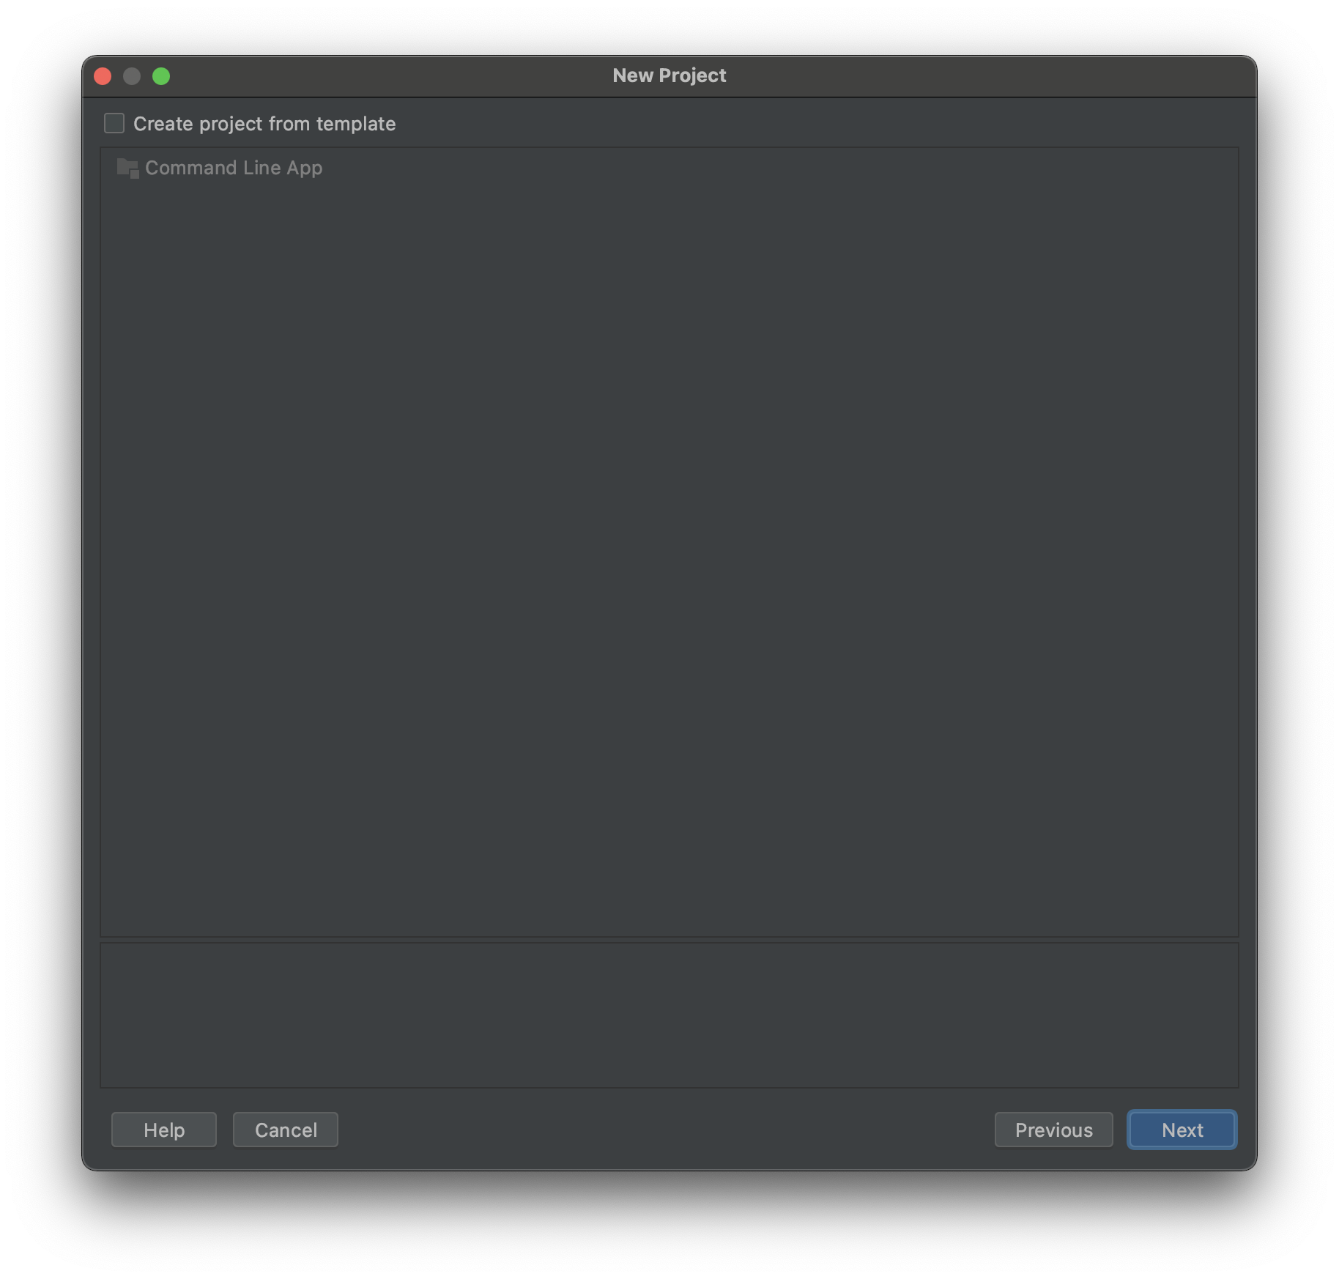
Guide - Template

Slide 7
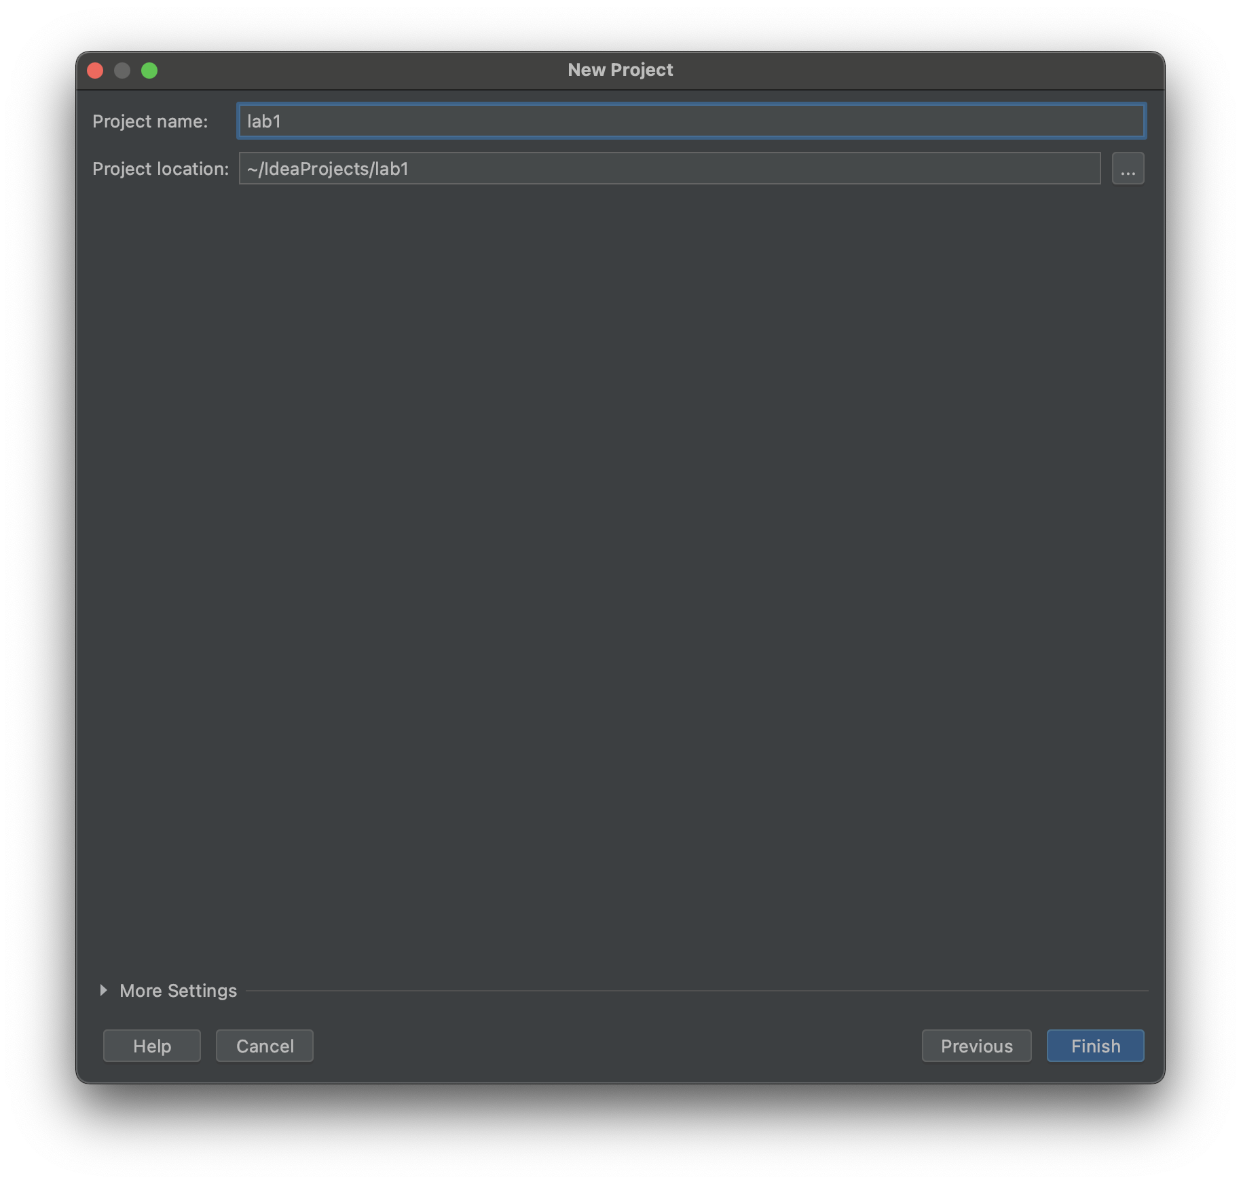
Guide - Name

Slide 8
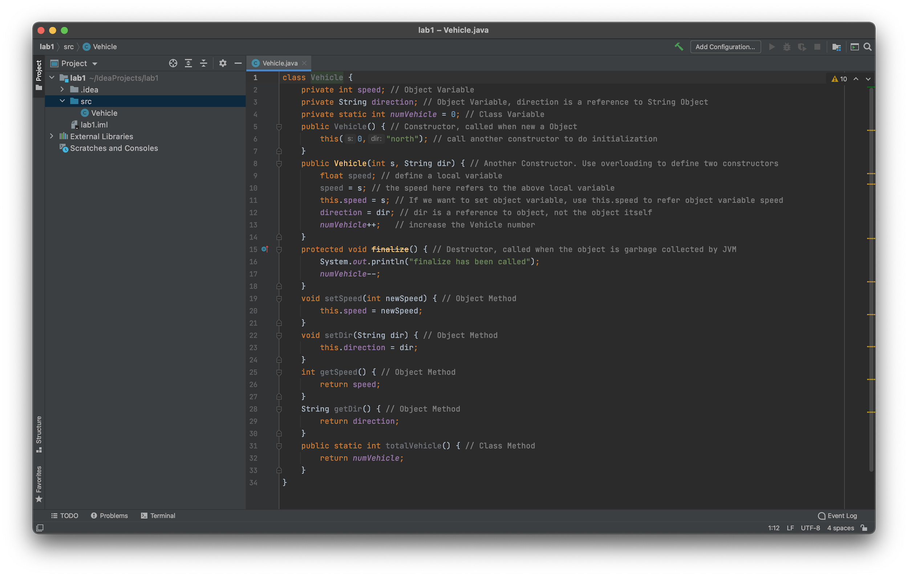
Guide - SRC

Slide 9
Create Test

Slide 10
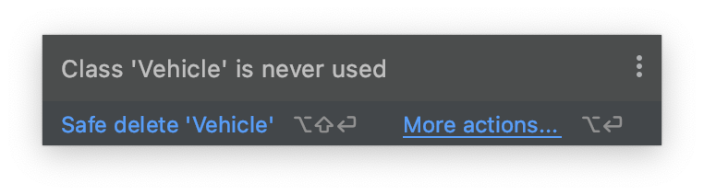
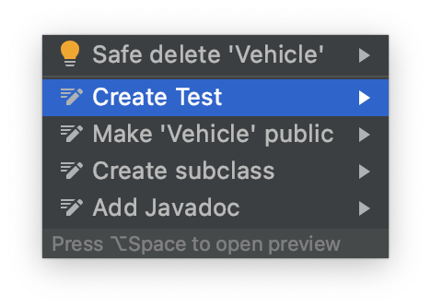
Create Test

Slide 11
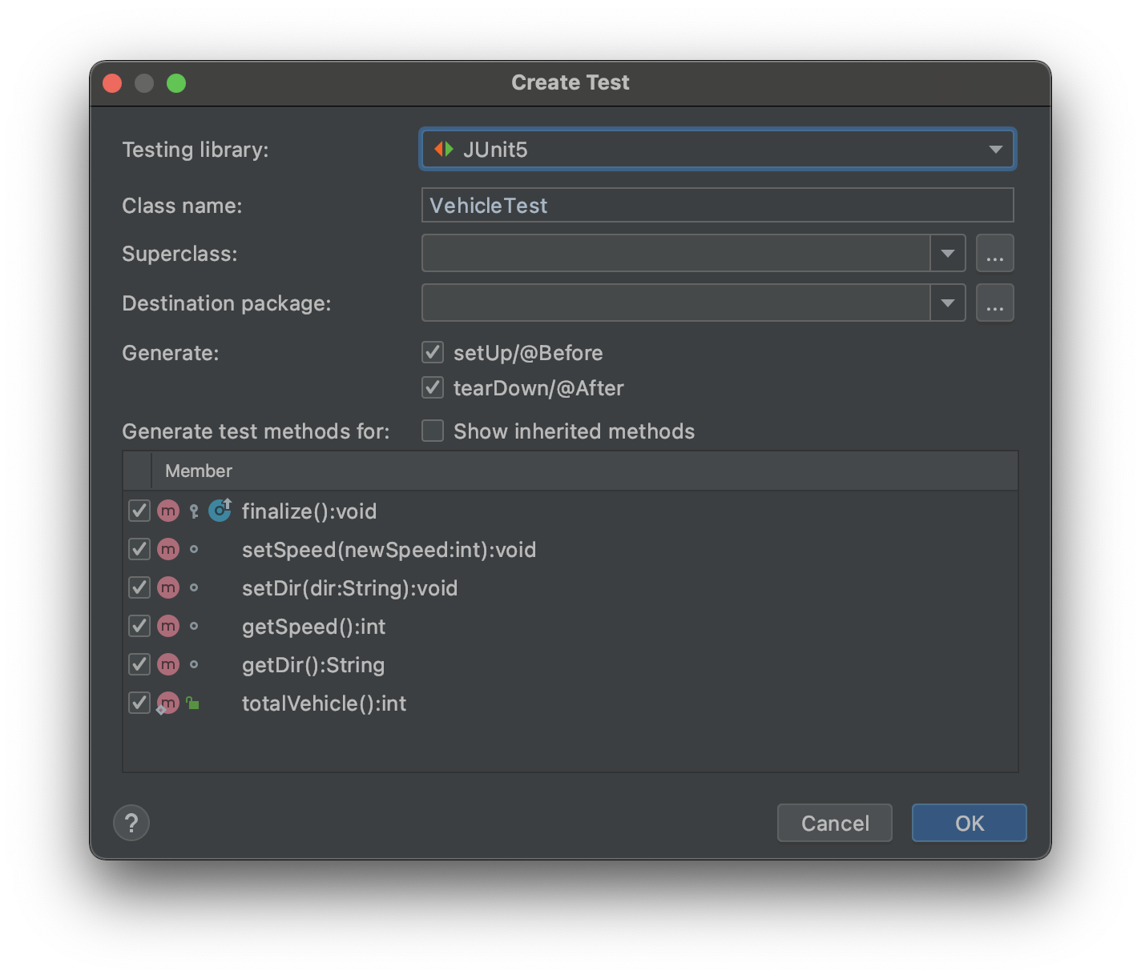
Create Test - JUnit 5

Slide 12
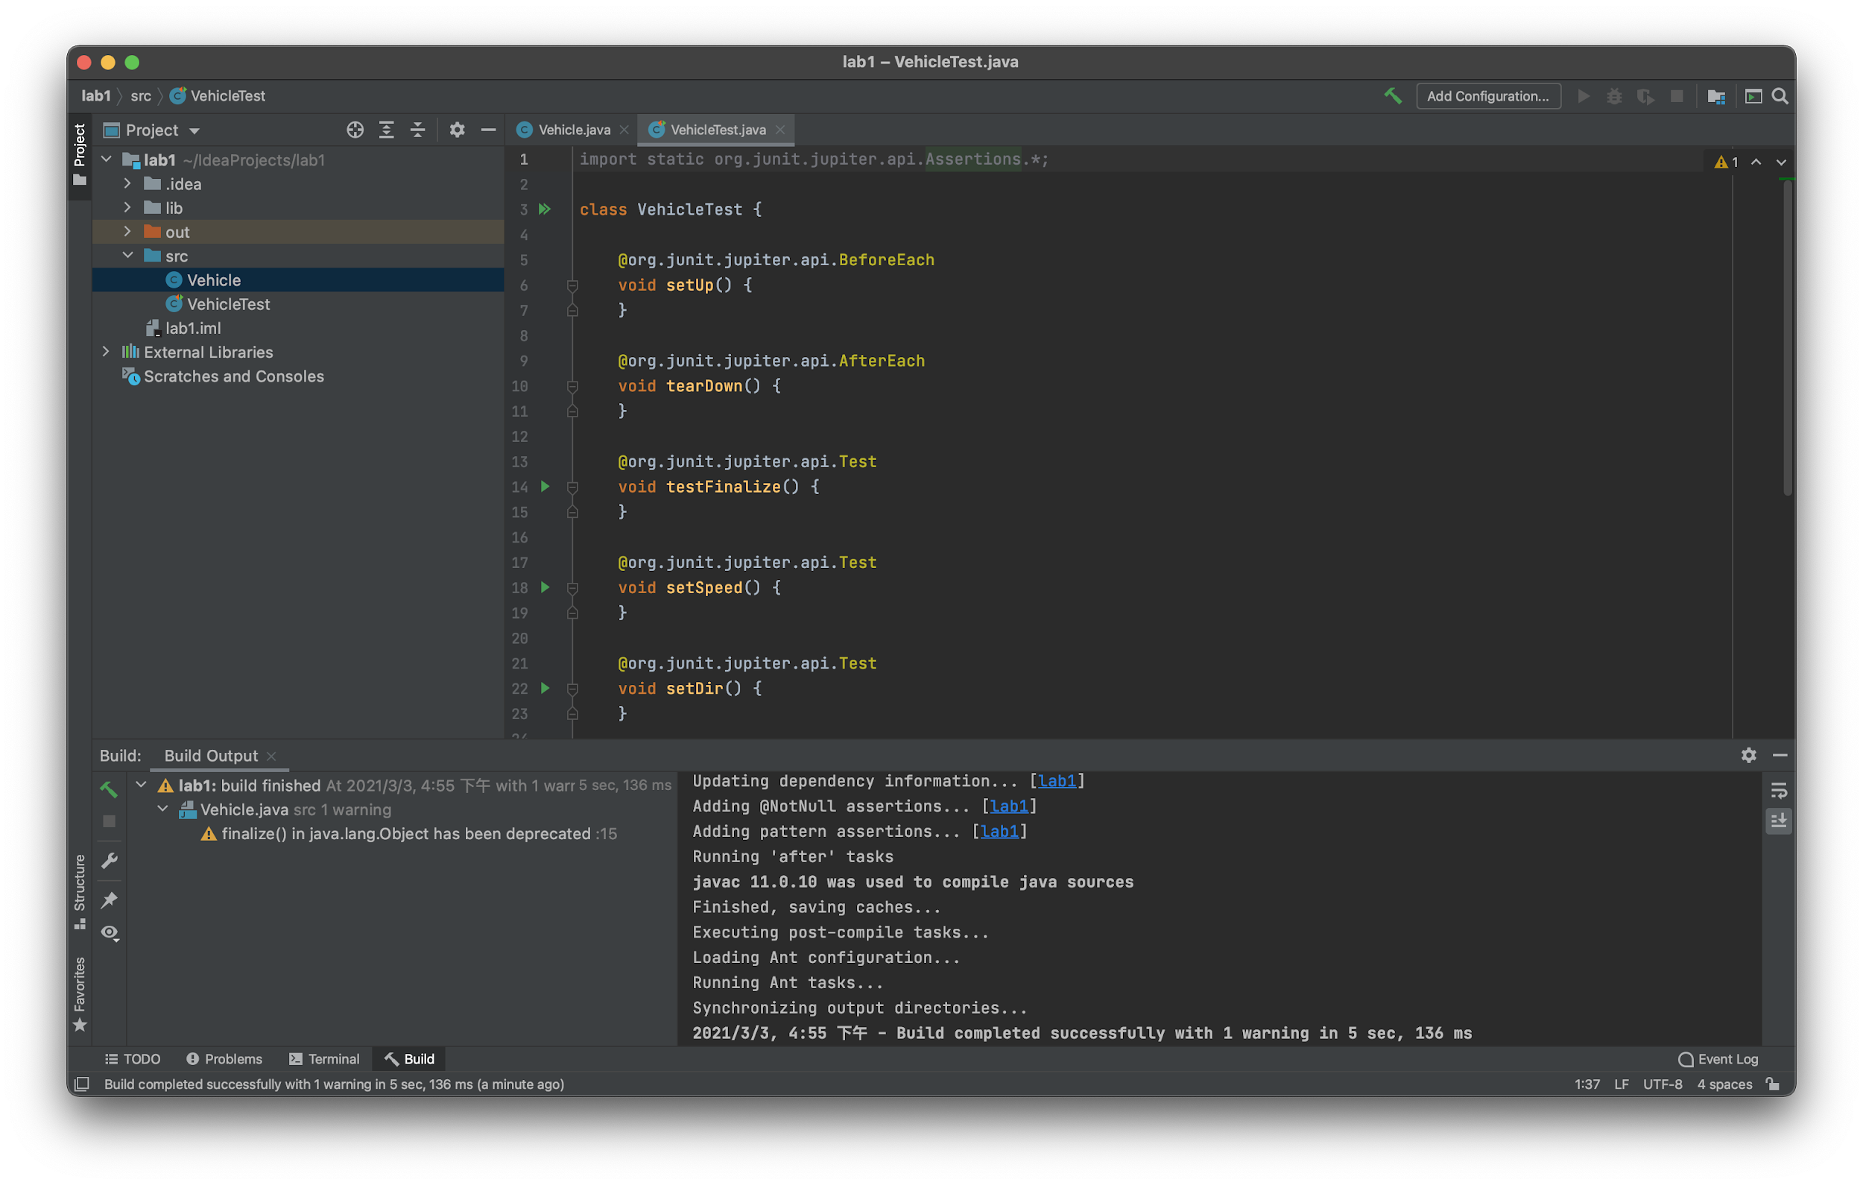
Create Test - New File

Slide 13
Code Coverage

Slide 14
Code Coverage
In computer science, test coverage is a measure used to describe the degree to which the source code of a program is executed when a particular test suite runs.
A program with high test coverage, measured as a percentage, has had more of its source code executed during testing, which suggests it has a lower chance of containing undetected software bugs compared to a program with low test coverage.
https://en.wikipedia.org/wiki/Code_coverage

Slide 15
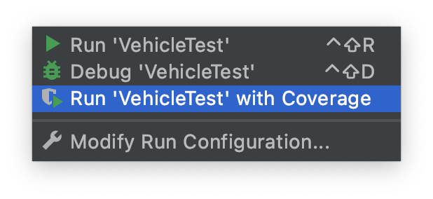
Get Code Coverage
z

Slide 16
JUnit 5

Slide 17
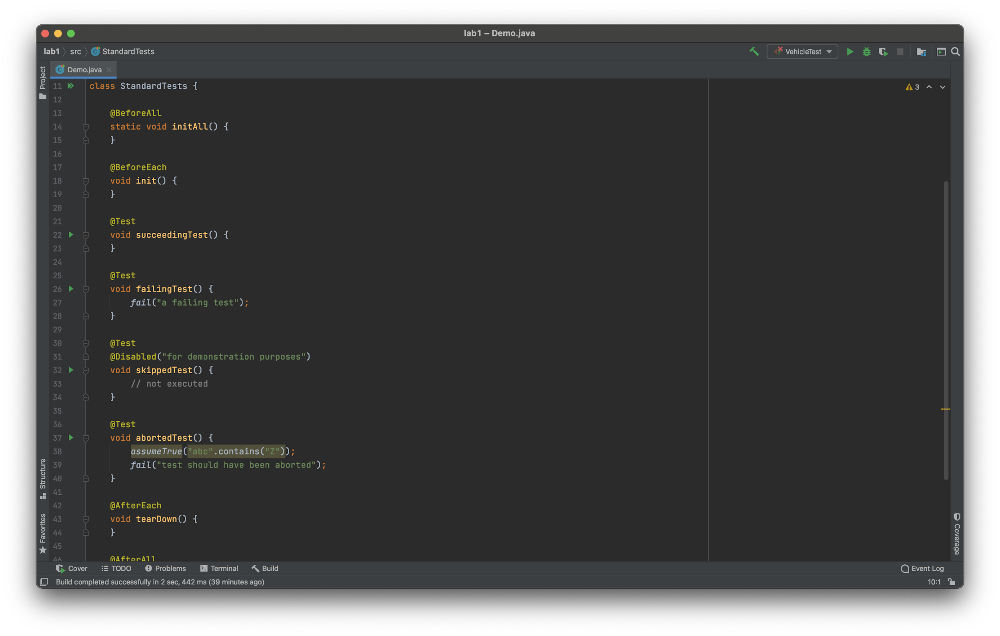
Test Classes and Methods
https://junit.org/junit5/docs/current/user-guide/#writing-tests-classes-and-methods

Slide 18
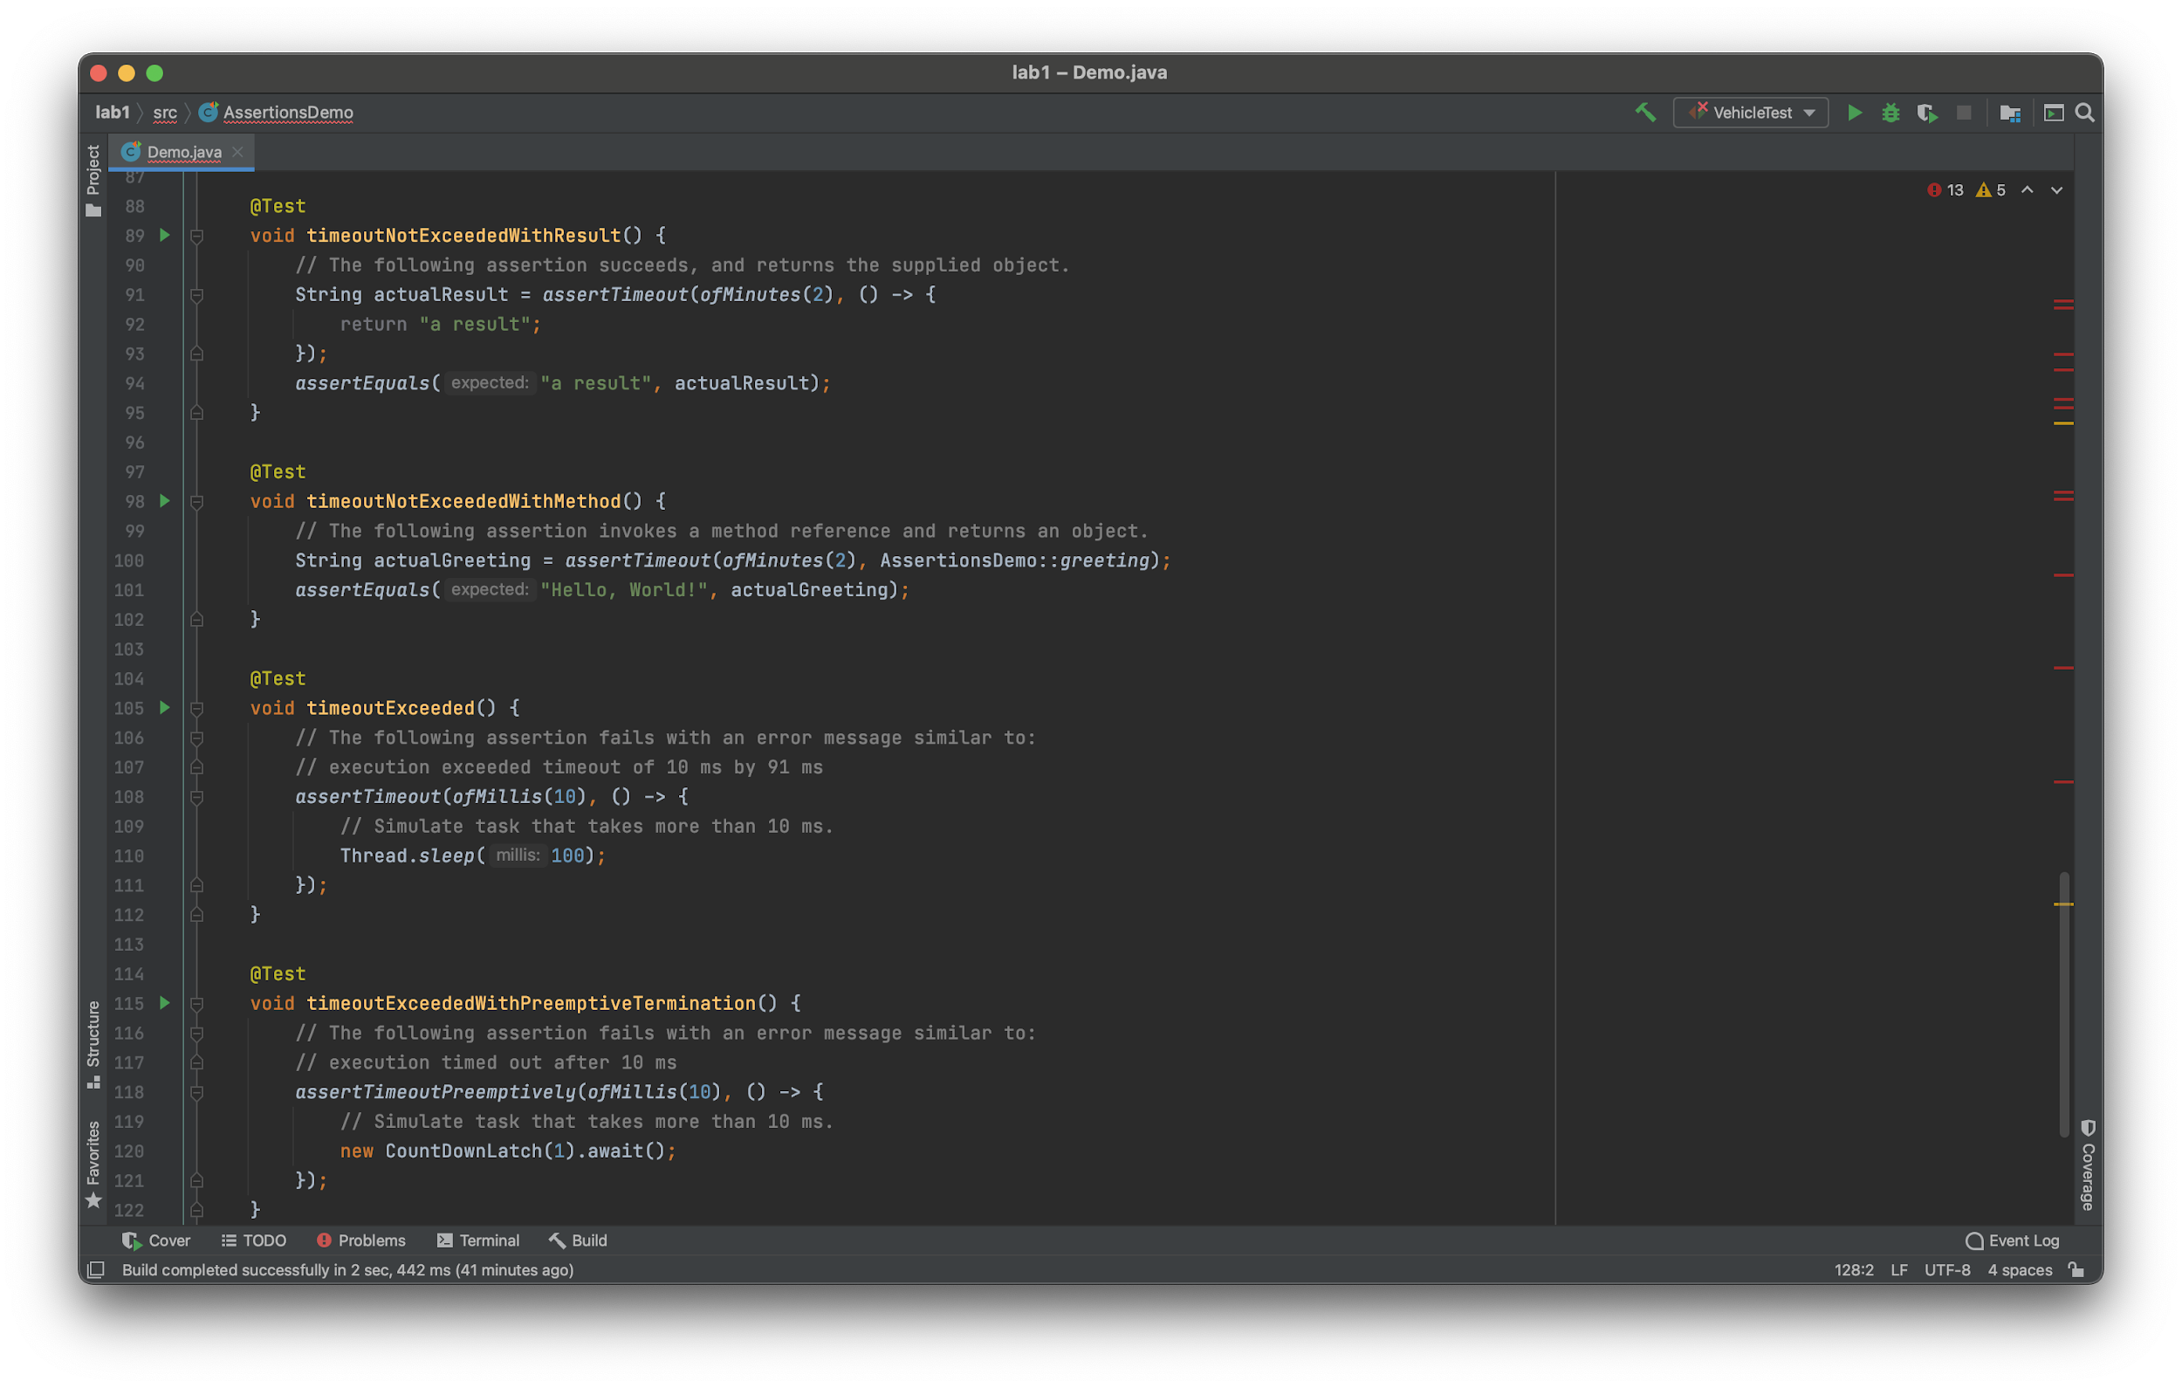
Assertions
https://junit.org/junit5/docs/current/user-guide/#writing-tests-assertions

Slide 19
Lab

Slide 20
Lab
Download Vehicle.java from Github.
https://github.com/iasthc/NYCU-Software-Testing-2021
Cover all code with test cases.
Deliverables shall include the following:
Test Code: VehicleTest.java
Screenshot of test coverage: STUDENT_ID.png
Do not compress the files and plagiarism.

Slide 21
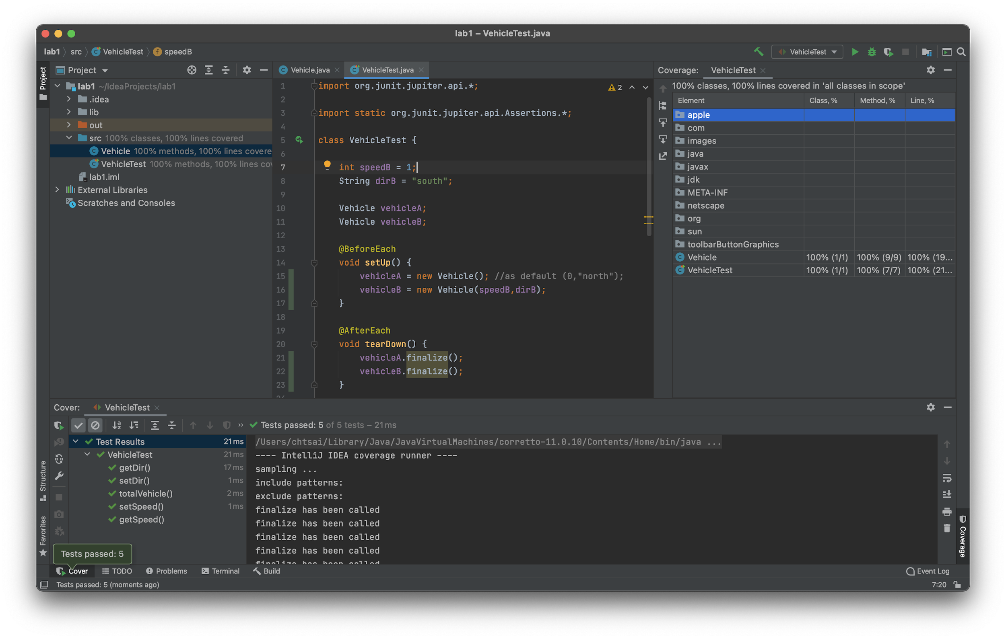
Lab

